Slide 1
Natural Language Processing NLG Summarization
Sudeshna Sarkar
16 Oct 2019

Slide 2
Natural Language Generation (NLG)
More on decoding algorithms
NLG tasks and neural approaches to them
NLG evaluation:

Slide 3
LMs and decoding algorithms

Slide 4
NLG
Natural Language Generation refers to any setting in which we generate (i.e. write) new text.
NLG is a subcomponent of:
Machine Translation
(Abstractive) Summarization
Dialogue (chit-chat and task-based)
Creative writing: storytelling, poetry-generation
Freeform Question Answering (i.e. answer is generated, not extracted from text or knowledge base)
Image captioning
• …

Slide 5
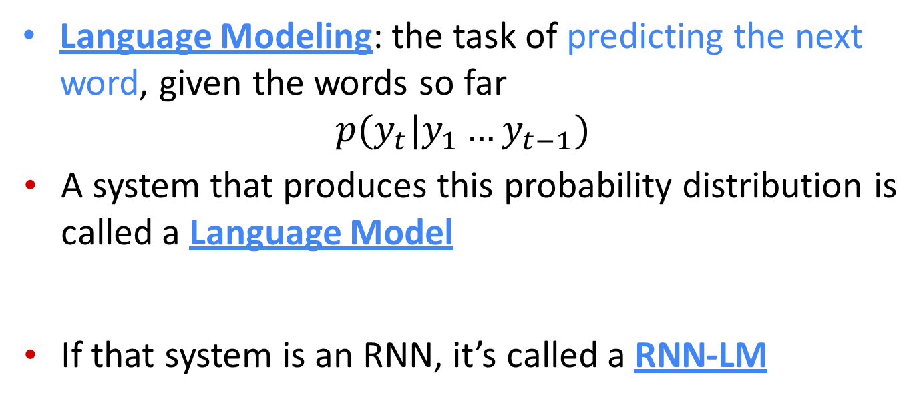
Recap
Language Modeling: the task of predicting the next word, given the words so far
$$p(y_{t}|y_{1}…y_{t−1})$$
A system that produces this probability distribution is called a Language Model
If that system is an RNN, it’s called a RNN-LM

Slide 6
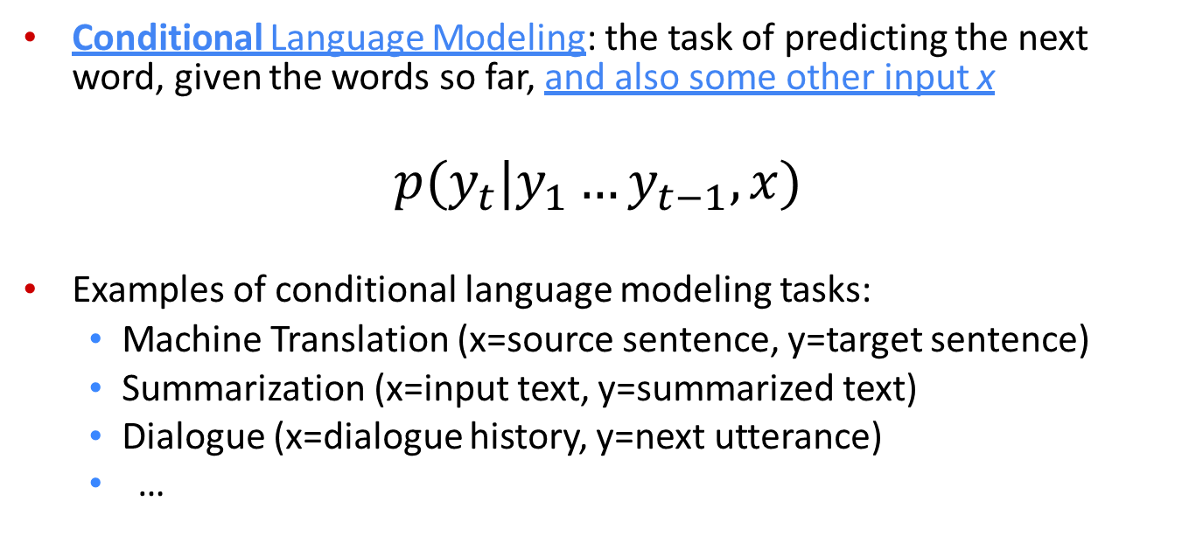
Recap
Conditional Language Modeling: the task of predicting the next word, given the words so far, and also some other input x
$$p(y_{t}|y_{1}…y_{t−1},x)$$
Examples of conditional language modeling tasks:
Machine Translation (x=source sentence, y=target sentence)
Summarization (x=input text, y=summarized text)
Dialogue (x=dialogue history, y=next utterance)
…

Slide 7
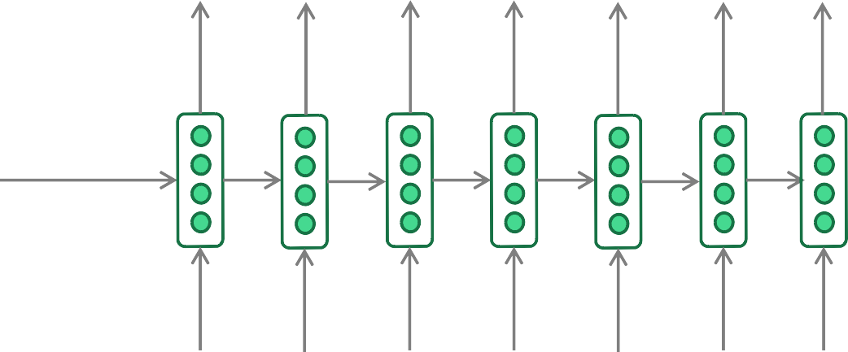
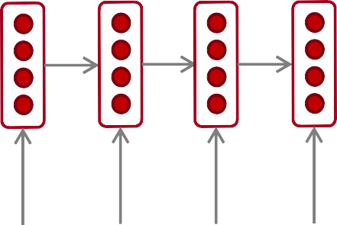
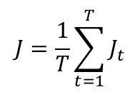
Recap: training a (conditional) RNN-LM
This example: Neural Machine Translation
= negative log prob of “he”
= negative log prob of “with”
= negative log prob of <END>
$$J=\frac{1}{T}\sum_{t=1}^{T}{J_{t}}$$
=
J1
+
J2
+
J3
J4 J5
J6
J7
+
+
+
Probability dist of next word
"!# "!$
"!% "!&
"!' "!₍ "!₎
Encoder RNN
Decoder RNN
il
m’
a entarté
<START> he
hit
me with
a
pie
Source sentence (from corpus)
Target sentence (from corpus)
During training, we feed the gold (aka reference) target sentence into the decoder, regardless of
what the decoder predicts. This training method is called Teacher Forcing.

Slide 8
Recap: decoding algorithms
Question: Once you’ve trained your (conditional) language model, how do you use it to generate text?
Answer: A decoding algorithm is an algorithm you use to generate text from your language model
We’ve learnt about two decoding algorithms:
Greedy decoding
Beam search

Slide 9
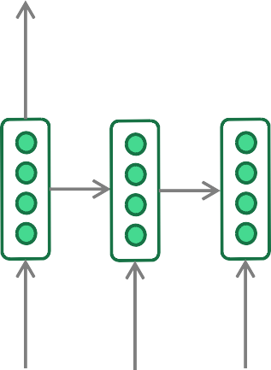
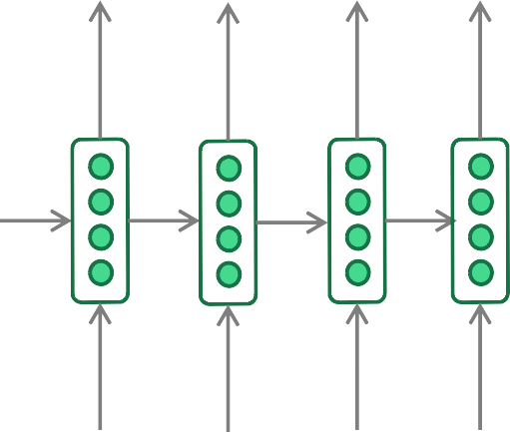
Recap: greedy decoding
A simple algorithm
On each step, take the most probable word (i.e. argmax)
Use that as the next word, and feed it as input on the next step
Keep going until you produce <END> (or reach some max length
he hit me with a pie <END>
argmax
argmax
argmax
argmax
argmax
argmax
argmax
<START> he hit me
with a pie
Due to lack of backtracking, output can be poor
(e.g. ungrammatical, unnatural, nonsensical)

Slide 10
Recap: beam search decoding
A search algorithm which aims to find a high-probability sequence (not necessarily the optimal sequence, though) by tracking multiple possible sequences at once.
Core idea: On each step of decoder, keep track of the k most probable partial sequences (which we call hypotheses)
k is the beam size
After you reach some stopping criterion, choose the sequence with the highest probability (factoring in some adjustment for length)

Slide 11
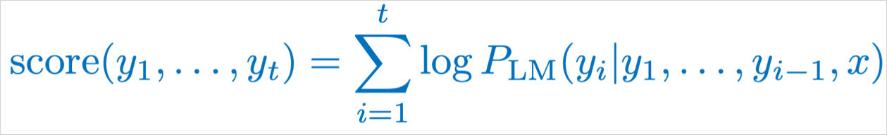
Recap: beam search decoding
Beam size = k = 2. Blue numbers =
-4.0
-4.8
tart
in
-2.8
pie
with
-4.3
-1.7
a
-3.4
-3.3
-4.5
-3.7
pie
-0.7
hit
he
me
tart
struck
-2.5
with
a
-4.6
-2.9
<START>
-2.9
on
one
-5.0
-1.6
hit
pie
-3.5
-4.3
was
I
struck
tart
got
-0.9
-3.8
-5.3
-1.8

Slide 12
What’s the effect of changing beam size k?
Small k has similar problems to greedy decoding (k=1)
Ungrammatical, unnatural, nonsensical, incorrect
Larger k means you consider more hypotheses
Increasing k reduces some of the problems above
Larger k is more computationally expensive
But increasing k can introduce other problems:
For NMT, increasing k too much decreases BLEU score (Tu et al, Koehn et al). This is primarily because large-k beam search produces too- short translations (even with score normalization!)
In open-ended tasks like chit-chat dialogue, large k can make output more generic (see next slide)
Neural Machine Translation with Reconstruction, Tu et al, 2017 https://arxiv.org/pdf/1611.01874.pdf
Six Challenges for Neural Machine Translation, Koehn et al, 2017 https://arxiv.org/pdf/1706.03872.pdf

Slide 13

Effect of beam size in chitchat dialogue
Beam size | Model response
1 | I love to eat healthy and eat healthy
2 | That is a good thing to have
3 | I am a nurse so I do not eat raw food
4 | I am a nurse so I am a nurse
5 | Do you have any hobbies?
6 | What do you do for a living?
7 | What do you do for a living?
8 | What do you do for a living?
Low beam size: More on-topic but nonsensical;
bad English
I mostly eat a fresh and raw diet, so I save on groceries
High beam size: Converges to safe, “correct” response, but it’s generic and less relevant
Human chit-chat partner

Slide 14
Sampling-based decoding
Both of these are more efficient than beam search
– no multiple hypotheses
Pure sampling
On each step t, randomly sample from the probability distribution P_{t} to obtain your next word.
Like greedy decoding, but sample instead of argmax.
Top-n sampling*
On each step t, randomly sample from P_{t,} restricted to just the top-n most probable words
Like pure sampling, but truncate the probability distribution
n=1 is greedy search, n=V is pure sampling
Increase n to get more diverse/risky output
Decrease n to get more generic/safe output
16
*Usually called top-k sampling, but here we’re avoiding confusion with beam size k

Slide 15
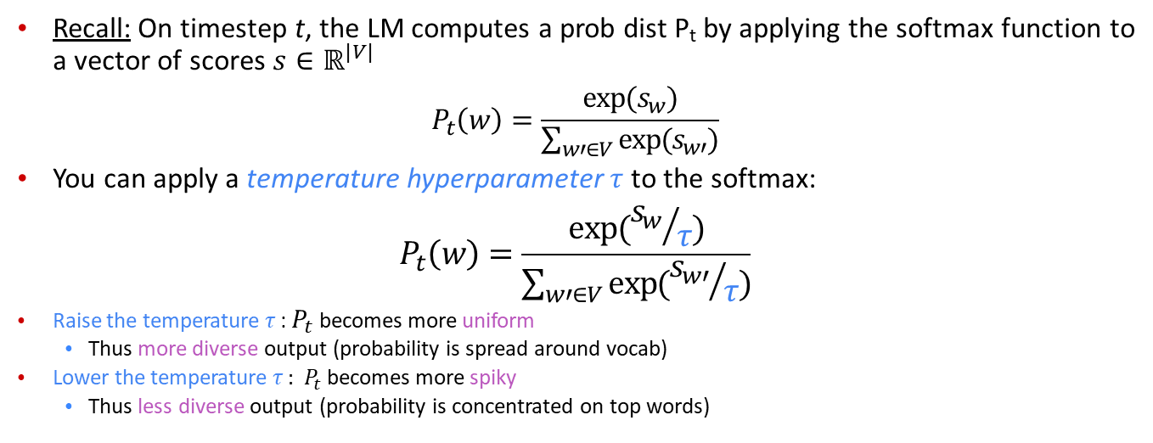
Softmax temperature
Recall: On timestep t, the LM computes a prob dist P_{t} by applying the softmax function to a vector of scores $s∈ℝ^{|V|}$
$$P_{t}\left(w\right)=\frac{exp⁡(s_{w})}{\sum_{w′∈V}{exp⁡(s_{w′})}}$$
You can apply a temperature hyperparameter $τ$ to the softmax:
$$P_{t}\left(w\right)=\frac{exp⁡({s_{w}}/τ)}{\sum_{w′∈V}{exp⁡({s_{w′}}/τ)}}$$
Raise the temperature $τ$: $P_{t}$ becomes more uniform
Thus more diverse output (probability is spread around vocab)
Lower the temperature $τ$: $P_{t}$ becomes more spiky
Thus less diverse output (probability is concentrated on top words)
Note: softmax temperature is not a decoding algorithm!
It’s a technique you can apply at test time, in conjunction with

Slide 16
Decoding algorithms: in summary
Greedy decoding is a simple method; gives low quality output
Beam search (especially with high beam size) searches for high- probability output
Delivers better quality than greedy, but if beam size is too high, can return high-probability but unsuitable output (e.g. generic, short)
Sampling methods are a way to get more diversity and randomness
Good for open-ended / creative generation (poetry, stories)
Top-n sampling allows you to control diversity
Softmax temperature is another way to control diversity
It’s not a decoding algorithm! It's a technique that can be applied alongside any decoding algorithm.

Slide 17
NLG tasks and neural approaches to them

Slide 18
Summarization: task definition
Task: given input text x, write a summary y which is shorter and contains the main information of x.
Summarization can be single-document or multi-document.
Single-document means we write a summary y of a single document x.
Multi-document means we write a summary y of multiple documents x₁,…,x_{n}
Typically x₁,…,x_{n} have overlapping content: e.g. news articles about the same event

Slide 19
Summarization: task definition
Within single-document summarization, there are datasets with source documents of different lengths and styles:
Gigaword: first one or two sentences of a news article → headline (aka sentence compression)
LCSTS (Chinese microblogging): paragraph → sentence summary
NYT, CNN/DailyMail: news article → (multi)sentence summary
Wikihow (new!): full how-to article → summary sentences
Sentence simplification is a different but related task: rewrite the source text in a simpler (sometimes shorter) way
Simple Wikipedia: standard Wikipedia sentence → simple version
Newsela: news article → version written for children
List of summarization datasets, papers, and codebases: https://github.com/mathsyouth/awesome-text-summarization

Slide 20
Summarization
Indian Express — A massive earthquake of magnitude 7.3 struck Iraq on Sunday, 103 kms (64 miles) southeast of the city of As-Sulaymaniyah, the US Geological Survey said, reports Reuters. US Geological Survey ini:ally said the quake was of a magnitude 7.2, before revising it to 7.3.
The quake has been felt in several Iranian cities and eight villages have been damaged. Electricity has also been disrupted at many places, suggest few TV reports.
Summary A massive earthquake of magnitude 7.3 struck Iraq on Sunday. The epicenter was close to the Iranian border. Eight villages were damaged and six people were killed in Iran.

Slide 21
What makes a good summary?
Summary
A strong earthquake of magnitude 7.3 struck Iraq and Iran on Sunday. The epicenter was close to the Iranian border. Eight villages were damaged and six people were killed in Iran.
Content selection: pick the right content
Right content was repeated within and across documents
Domain-speciﬁc (magnitude + epicenter of earthquakes are important)
Generation: write the summary
Extraction: pick whole sentences from the summary
Compression: compress those sentences but basically just do deletion
Abstraction: rewrite + re-express content freely

Slide 22
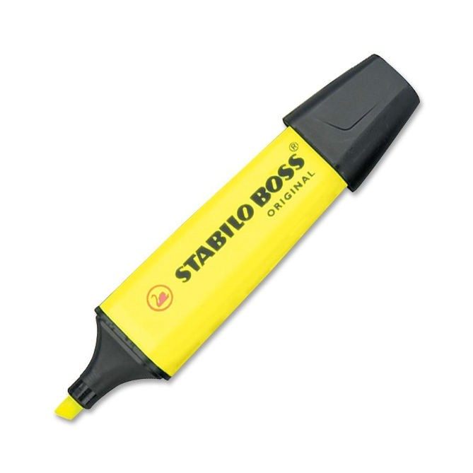

Summarization: two main strategies
Extractive summarization Abstractive summarization
Select parts (typically sentences) of the original text to form a summary.
Generate new text using natural language generation techniques.
Easier
Restrictive (no paraphrasing)
More difficult
More flexible (more human)
22

Slide 23
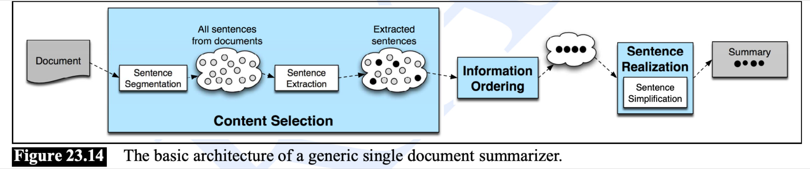
Non-neural summarization
Pre-neural summarization systems were mostly extractive
They typically had a pipeline:
Content selection: choose some sentences to include
Information ordering: choose an ordering of those sentences
Sentence realization: edit the sequence of sentences (e.g. simplify, remove parts, fix continuity issues)

Slide 24
Pre-neural summarization
Pre-neural content selection algorithms:
Sentence scoring functions can be based on:
Presence of topic keywords, computed via e.g. tf-idf
Features such as where the sentence appears in the document
Graph-based algorithms view the document as a set of sentences (nodes), with edges between each sentence pair
Edge weight is proportional to sentence similarity
Use graph algorithms to identify sentences which are central in the graph

Slide 25
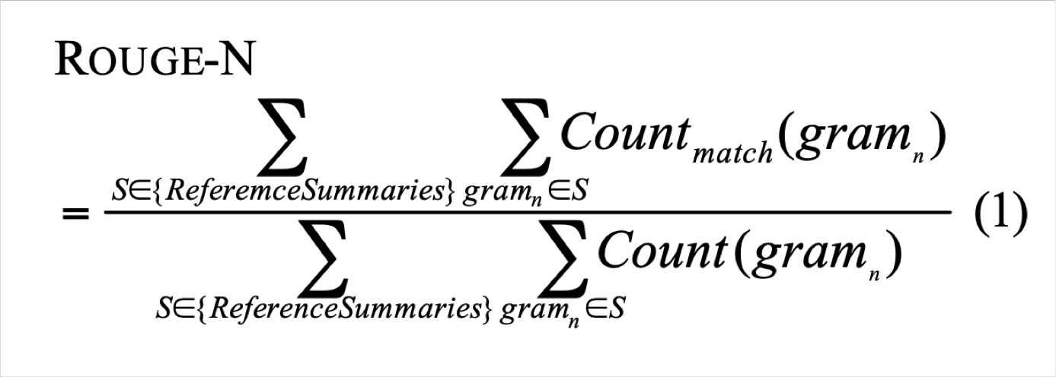
Summarization evaluation: ROUGE
ROUGE (Recall-Oriented Understudy for Gisting Evaluation)
Like BLEU, it’s based on n-gram overlap. Differences:
ROUGE has no brevity penalty
ROUGE is based on recall, while BLEU is based on precision
Arguably, precision is more important for MT (then add brevity penalty to fix under-translation), and recall is more important for summarization (assuming you have a max length constraint)
However, often a F1 (combination of precision and recall) version of ROUGE is reported anyway.
ROUGE: A Package for Automatic Evaluation of Summaries, Lin, 2004 http://www.aclweb.org/anthology/W04-1013

Slide 26
Summarization evaluation: ROUGE
BLEU is reported as a single number, which is combination of the precisions for n=1,2,3,4 n-grams
ROUGE scores are reported separately for each n-gram
The most commonly-reported ROUGE scores are:
ROUGE-1:* unigram overlap
ROUGE-2: bigram overlap
ROUGE-L: longest common subsequence overlap
There is now a convenient Python implementation of ROUGE!
Python implementation of ROUGE: https://github.com/google-research/google-research/tree/master/rouge

Slide 27
Evaluation Metric
METEOR
Sentence-level similarity scores. Search all possible alignments.
Exact
Match words if they are identical.
Stem
Match stem words using a language appropriate Snowball Stemmer (Porter, 2001).
Synonym
Match words that share membership in any synonym set based on WordNet database.
Paraphrase
Match phrases if they are listed as paraphrases in a defined paraphrase table.

Slide 28
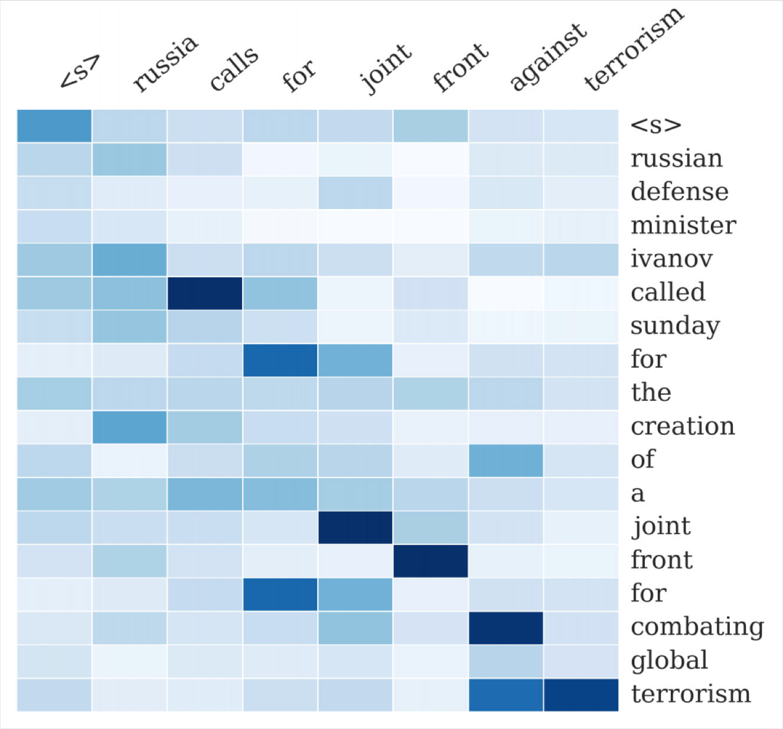
Neural summarization (2015 - present)
2015: Rush et al. publish the first seq2seq summarization paper
Single-document abstractive summarization is a translation task!
Thus we can apply standard seq2seq + attention NMT methods
A Neural Attention Model for Abstractive Sentence Summarization, Rush et al, 2015 https://arxiv.org/pdf/1509.00685.pdf

Slide 29
Neural summarization (2015 - present)
Since 2015, there have been lots more developments!
Making it easier to copy
But also preventing too much copying!
Hierarchical / multi-level attention
More global / high-level content selection
Using Reinforcement Learning to directly maximize ROUGE, or other discrete goals (e.g. length)
Resurrecting pre-neural ideas (e.g. graph algorithms for content selection) and working them into neural systems
• …
List of summarization datasets, papers, and codebases: https://github.com/mathsyouth/awesome-text-summarization
A Survey on Neural Network-Based Summarization Methods, Dong, 2018 https://arxiv.org/pdf/1804.04589.pdf

Slide 30
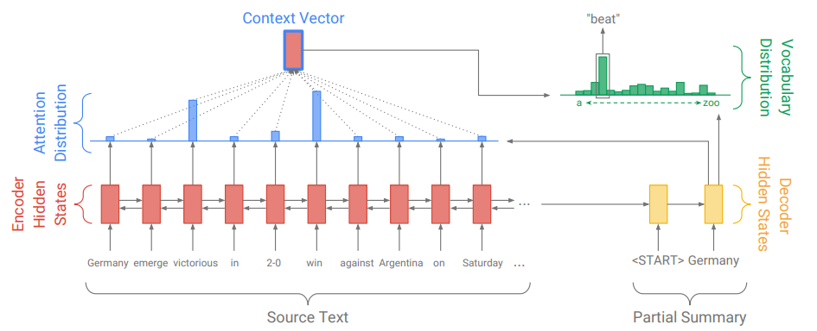
Abstractive Summarization: Sequence-to-sequence attentional model
Problems?
Out Of Vocabulary words

Slide 31
Neural summarization: copy mechanisms
Seq2seq+attention systems are good at writing fluent output, but bad at copying over details (like rare words) correctly
Copy mechanisms use attention to enable a seq2seq system to easily copy words and phrases from the input to the output
Clearly this is very useful for summarization
Allowing both copying and generating gives us a hybrid extractive/abstractive approach
There are several papers proposing copy mechanism variants:
Language as a Latent Variable: Discrete Generative Models for Sentence Compression, Miao et al, 2016 https://arxiv.org/pdf/1609.07317.pdf
Abstractive Text Summarization using Sequence-to-sequence RNNs and Beyond, Nallapati et al, 2016 https://arxiv.org/pdf/1602.06023.pdf
Incorporating Copying Mechanism in Sequence-to-Sequence Learning, Gu et al, 2016 https://arxiv.org/pdf/1603.06393.pdf
etc

Slide 32
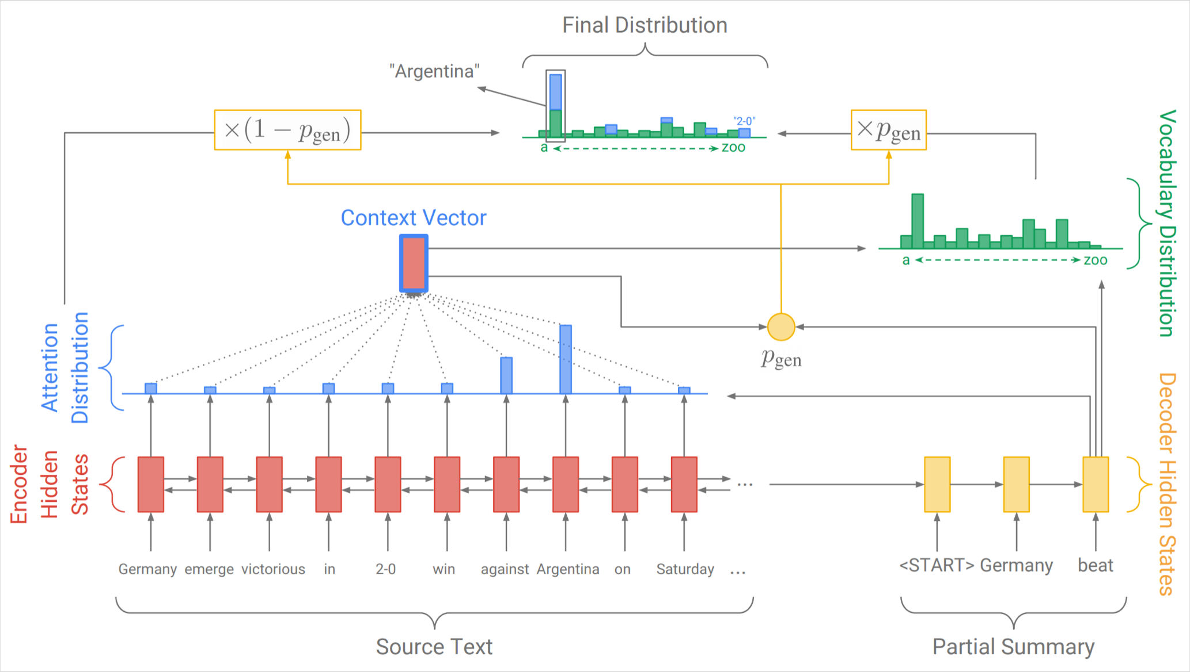
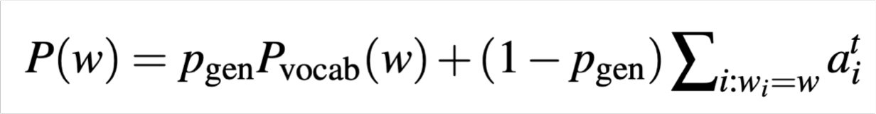
Neural summarization: copy mechanisms
One example of how to do a copying mechanism:
On each decoder step, calculate p_{gen}, the probability of generating the next word (rather than copying it). The final distribution is a mixture of the generation (aka “vocabulary”) distribution, and the copying (i.e. attention) distribution:
Get To The Point: Summarization with Pointer-Generator Networks, See et al, 2017 https://arxiv.org/pdf/1704.04368.pdf

Slide 33
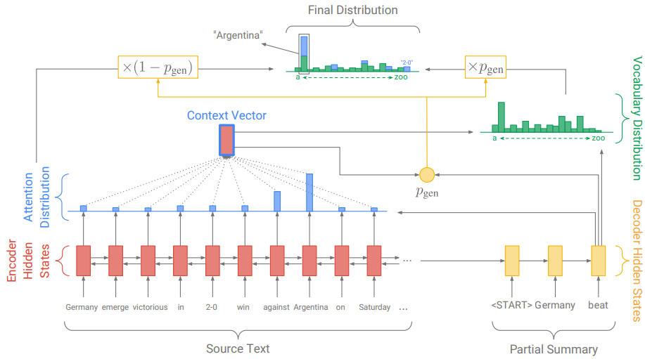

Slide 34
Neural summarization: copy mechanisms
Big problem with copying mechanisms:
They copy too much!
Mostly long phrases, sometimes even whole sentences
What should be an abstractive system collapses to a mostly extractive system.
Another problem:
They’re bad at overall content selection, especially if the input document is long
No overall strategy for selecting content

Slide 35
Neural summarization: better content selection
Recall: pre-neural summarization had separate stages for content selection and surface realization (i.e. text generation)
In a standard seq2seq+attention summarization system, these two stages are mixed in together
On each step of the decoder (i.e. surface realization), we do word-level content selection (attention)
This is bad: no global content selection strategy
One solution: bottom-up summarization

Slide 36
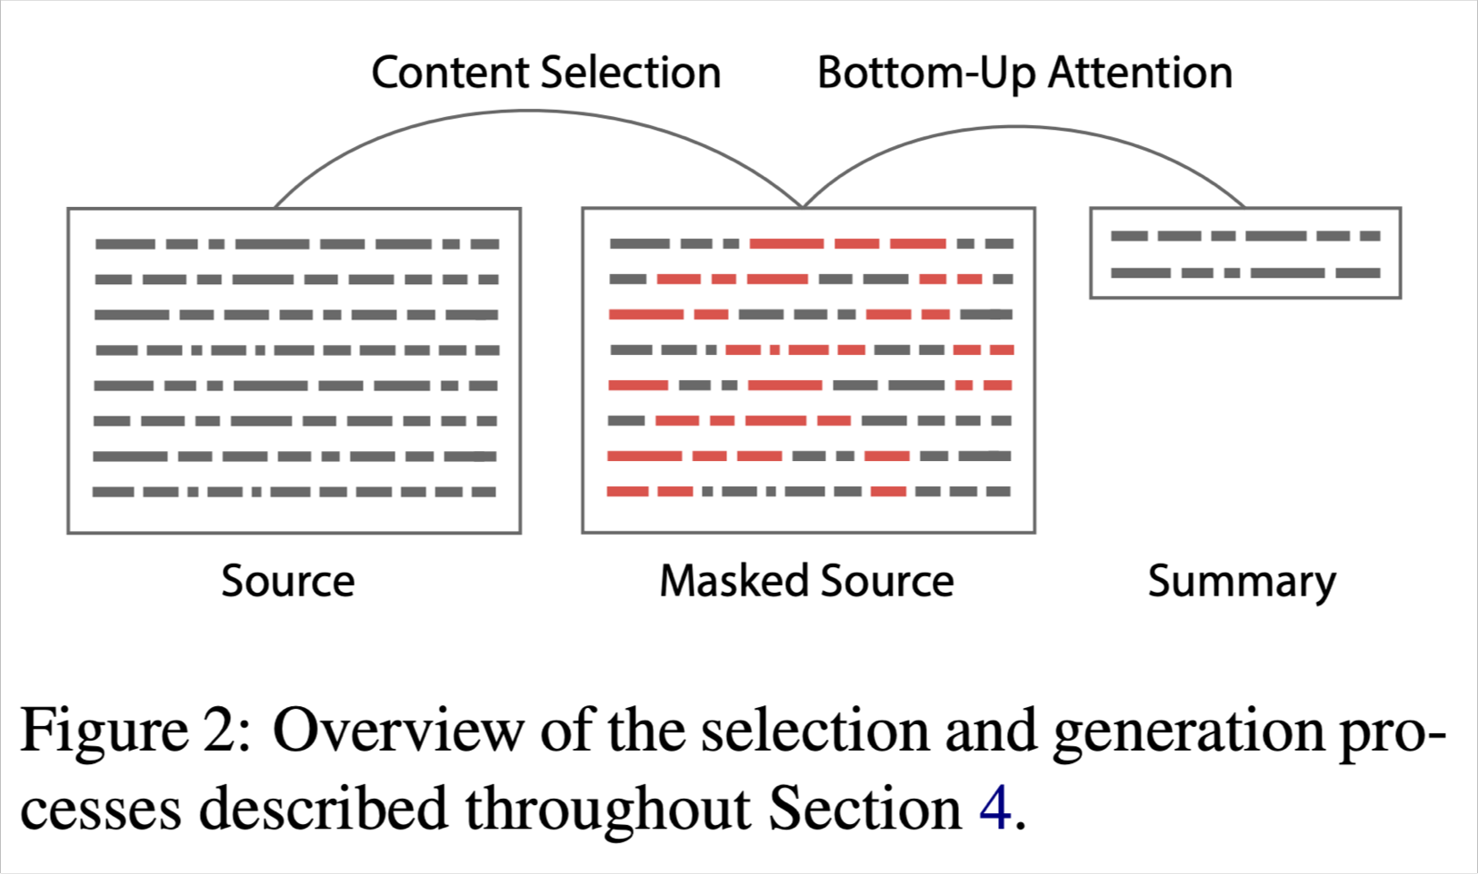
Bottom-up summarization
Content selection stage: Use a neural sequence-tagging model to tag words as include or don’t-include
Bottom-up attention stage: The seq2seq+attention system can’t attend to words tagged don’t-include (apply a mask)
Simple but effective!
Better overall content selection strategy
Less copying of long sequences (i.e. more abstractive output)
33
Bottom-Up Abstractive Summarization, Gehrmann et al, 2018 https://arxiv.org/pdf/1808.10792v1.pdf

Slide 37
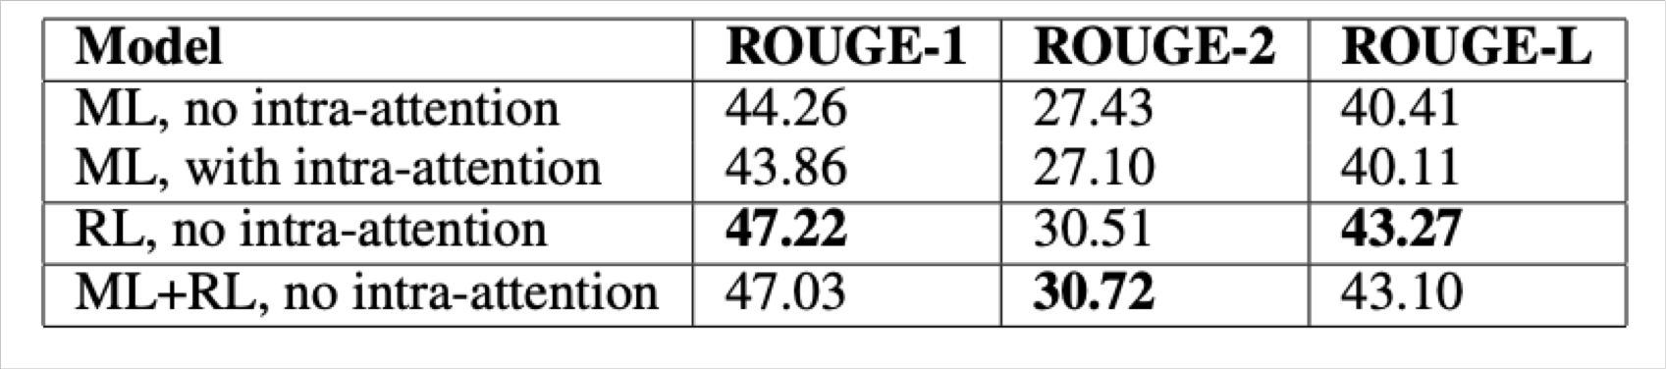
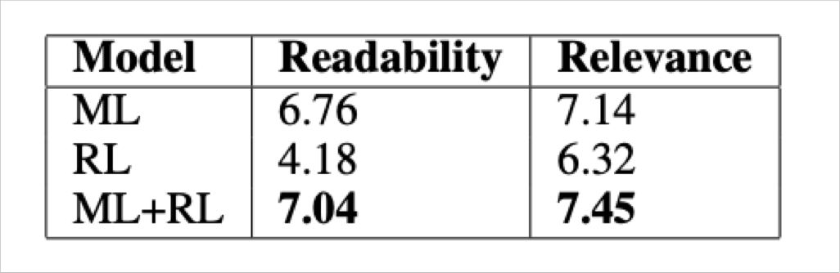
Neural summarization via Reinforcement Learning
In 2017 Paulus et al published a “deep reinforced” summarization model
Main idea: Use Reinforcement Learning (RL) to directly optimize ROUGE-L
By contrast, standard maximum likelihood (ML) training can’t directly optimize ROUGE-L because it’s a non-differentiable function
Interesting finding:
Using RL instead of ML achieved higher ROUGE scores, but lower human judgment scores
“We observed that our models with the highest ROUGE scores also generated barely- readable summaries.”
Overall, a hybrid approach does best!
A Deep Reinforced Model for Abstractive Summarization, Paulus et al, 2017 https://arxiv.org/pdf/1705.04304.pdf
34
Blog post: https://www.salesforce.com/products/einstein/ai-research/tl-dr-reinforced-model-abstractive-summarization/

